Slide 1
MAP WORK
FORM ONE

Slide 2

CONTENT
Definition of a picture, a plan and a map
Distinction between pictures, plans and maps
Types of maps
Uses of maps
Marginal information
Map scales
Use of scales

Slide 3
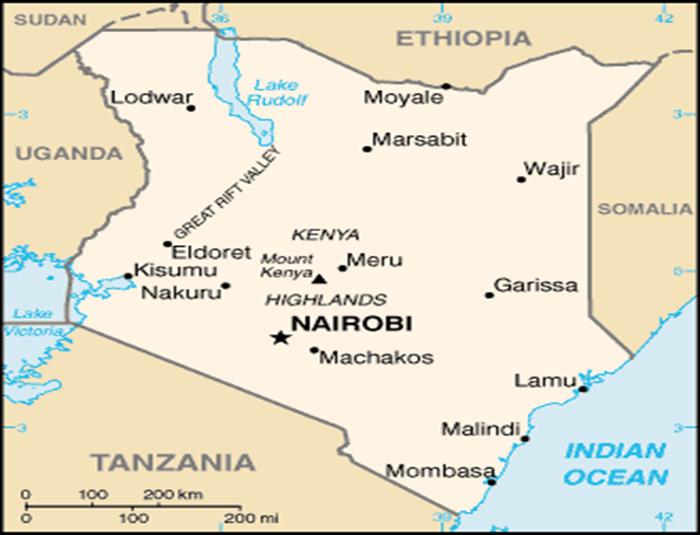
A MAP: It is a representation of part or whole of the earth surface on a flat surface e.g. on a sheet of paper OR a diagrammatic representation of the earth’s surface(or part of it).

Slide 4
A PLAN: It is a map of a very small place and drawn on a large scale OR is a drawing of two-dimensions used to describe a place or object e.g. a plan of a building.
Features
It is drawn for a specific purpose.
It is drawn to give specific information.
It is selective and gives many details.
(see an example in the next slide)

Slide 5
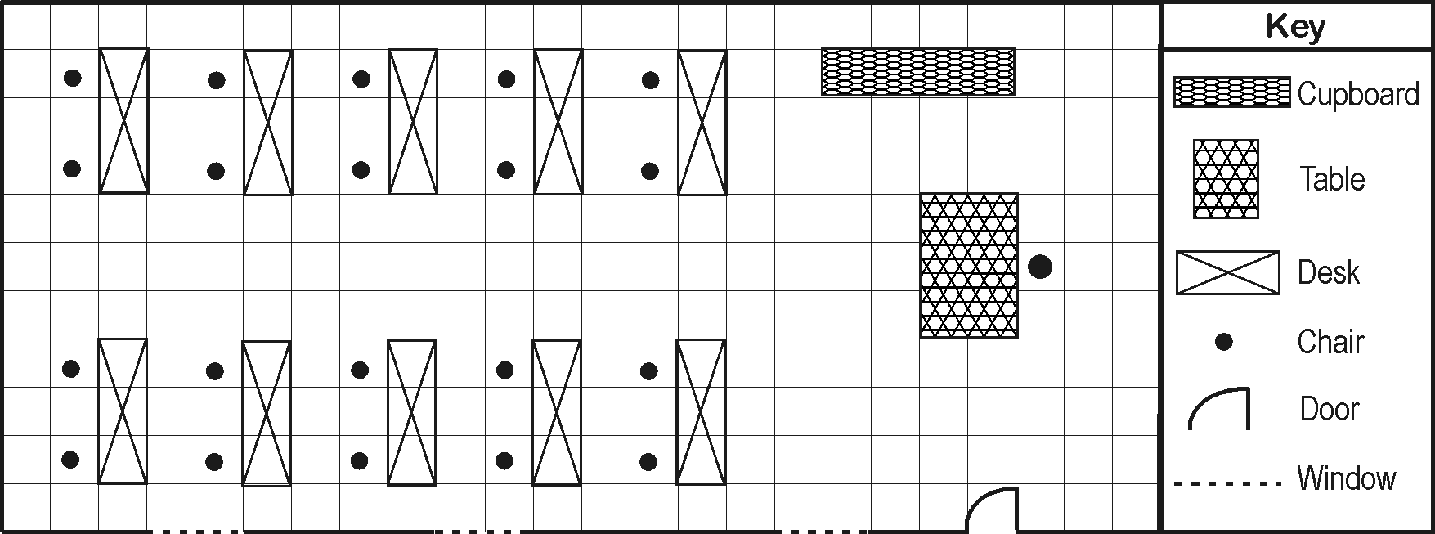
A CLASSROOM PLAN

Slide 6
Assignment 1
Draw the plan of your classroom at Magarini Secondary School.

Slide 7
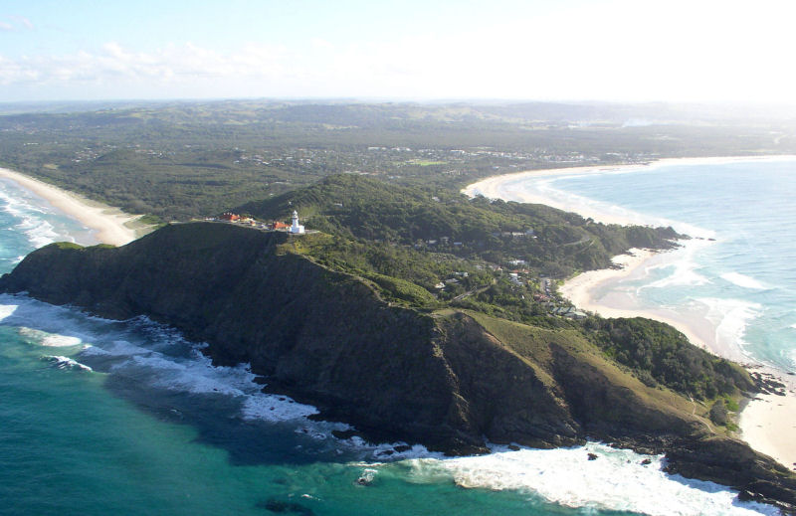
A PICTURE: It is an image of a real object in form of a photograph, a painting or a drawing.

Slide 8
TYPES OF MAPS
Sketch maps
Atlas maps
Topographical maps

Slide 9
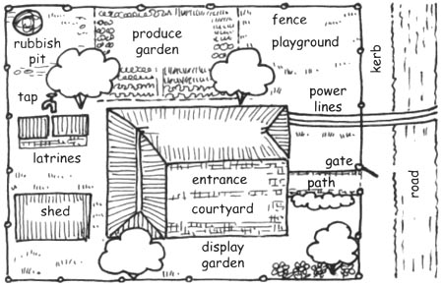
A SKETCH MAP: It is a map drawn from observation and represents the main features of an area. It’s not drawn to scale.
A SKETCH MAP OF A HOMESTEAD
N

Slide 10
Features of a good sketch map
It should be neat
It must have a title
It should be enclosed in a frame
It should have a key showing symbols and signs used or must be well labeled.
It should have a compass direction showing the north direction.
Assignment 2
Draw a sketch map of Magarini Secondary School compound.

Slide 11
ATLAS MAPS: It is a collection of many maps bound in one volume resembling a book. They are normally small scale maps and hence cover a larger ground area therefore containing a wide range of information on a small sheet of paper and may include:
Relief maps
Climatic maps
Vegetation maps
Political maps
Population maps

Slide 12
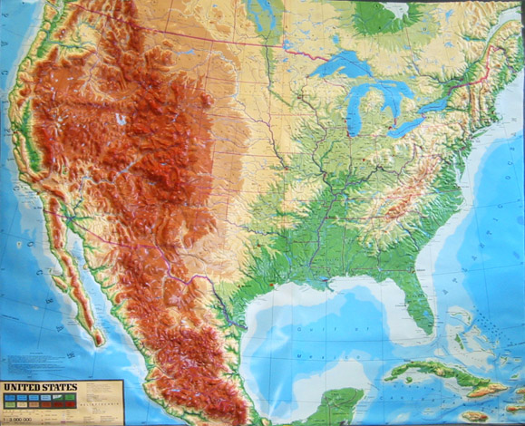
A RELIEF MAP OF THE USA

Slide 13
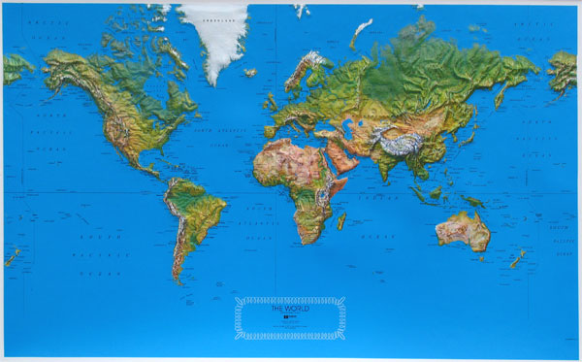
WORLD MAP SHOWING RELIEF

Slide 14
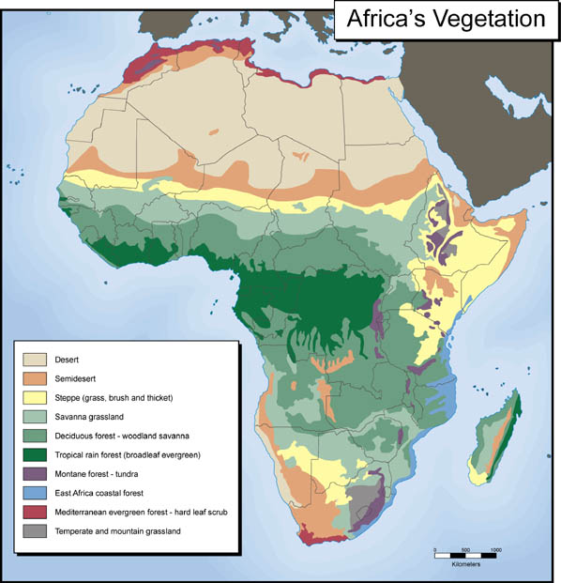

Slide 15
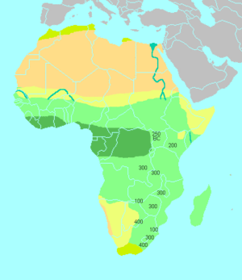
Simplified climatic map of Africa: Desert climate (yellow), the tropical savanna climate (light green) and the equatorial climate (dark green) of Equatorial Africa, and the " Mediterranean" south coast (olive) of Southern Africa and N.E Africa(Atlas).

Slide 16
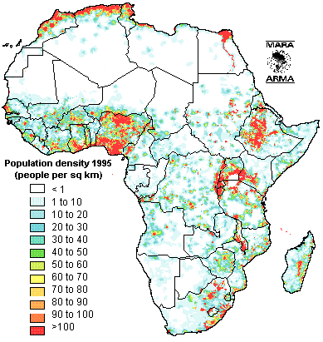
AFRICAS’ POPULATION DISTRIBUTION

Slide 17
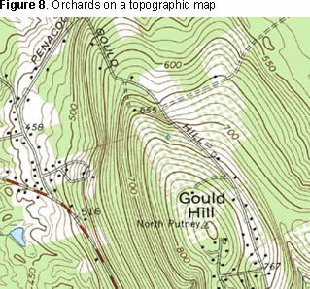
A TOPOGRAPHICAL MAP: It is a map showing selected number of physical and human features and their positions on the earth’s surface e.g. hills, farms etc. and can be medium or large scale map.

Slide 18
USES OF MAPS
To locate places/landforms on the earth’s surface.
To determine the size of a particular location
To provide different information about places e.g. climate and vegetation
Used by travelers to find out direction to particular places etc.
Used to summarize information quickly for future reference

Slide 19
MARGINAL INFORMATION
These are facts contained in the areas surrounding the map.
It is additional information besides the one already shown on the map.
The information includes: (Ref. to Silaloni Map)
Map series – It is the number identifying the map and is enclosed in a box e.g. {SK61}Y731
Sheet index number – It identifies the particular sheet from other adjoining sheets in the same series e.g. 197/2

Slide 20
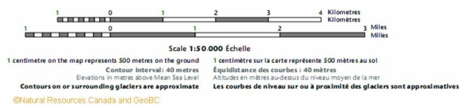
MARGINAL INFORMATION
3. Sheet name/title – It is the name of the map and represents an area and NOT a specific town or a village e.g. Silaloni and not Silaloni Trading Centre.
4. The scale – It is shown at the N.W corner of the map i.e. 1:50,000 or as a linear just below the map in kilometers or meters.
1c11ccmmmmmmmmmm1wwwwfff
1cm on the map represents 500m or 0.5km on the ground

Slide 21
5. Edition – The year when the map was last published e.g. 1991.
6. Copyright and publisher – The authority that publishes the map e.g. Survey of Kenya whereas the copyright © belongs to the government.
7. The Key – It contains symbols and signs that are used to represent natural and man-made features. N/B: Some symbols shown may not be found in the map.
8. Grid system numbers – These are numbers for grid Easting and Northings in the inner margin of the map.

Slide 22
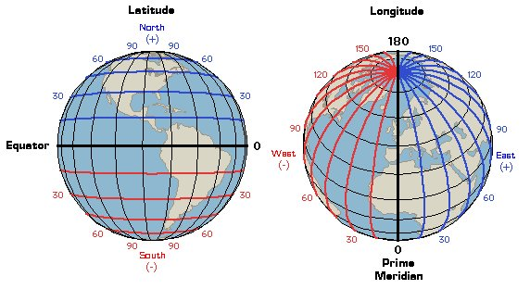
9. Latitudes and Longitudes – They show areas North or South of the equator and East or West of the prime meridian respectively.

Slide 23
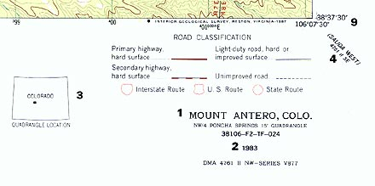
10. Grid system numbers – These are numbers for grid Easting and Northings in the inner margin of the map.
Observe the grid reference figures and the latitudes/longitudes above.

Slide 24
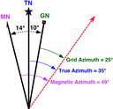
11. Compass direction – It shows the relationship between the true north, grid north and magnetic north. It also states the magnetic variation i.e. difference between the magnetic north and the true north.
TN
MN
GN
14ᵒ
10ᵒ
GRID NORTH
TRUE NORTH
MAGNETIC NORTH

Slide 25
12. Index to adjoining sheets – It is a box containing nine squares where the center square represents the map sheet.
INDEX TO ADJOINING SHEETS
191/3 Ndakithima | 191/4 Mapotea | 192/3 Vitengeni
197/1 Dokata | 197/2 Silaloni | 198/1 Bamba
197/3 Mikamini | 197/4 Mariakani | 198/3 Mazeras

Slide 26
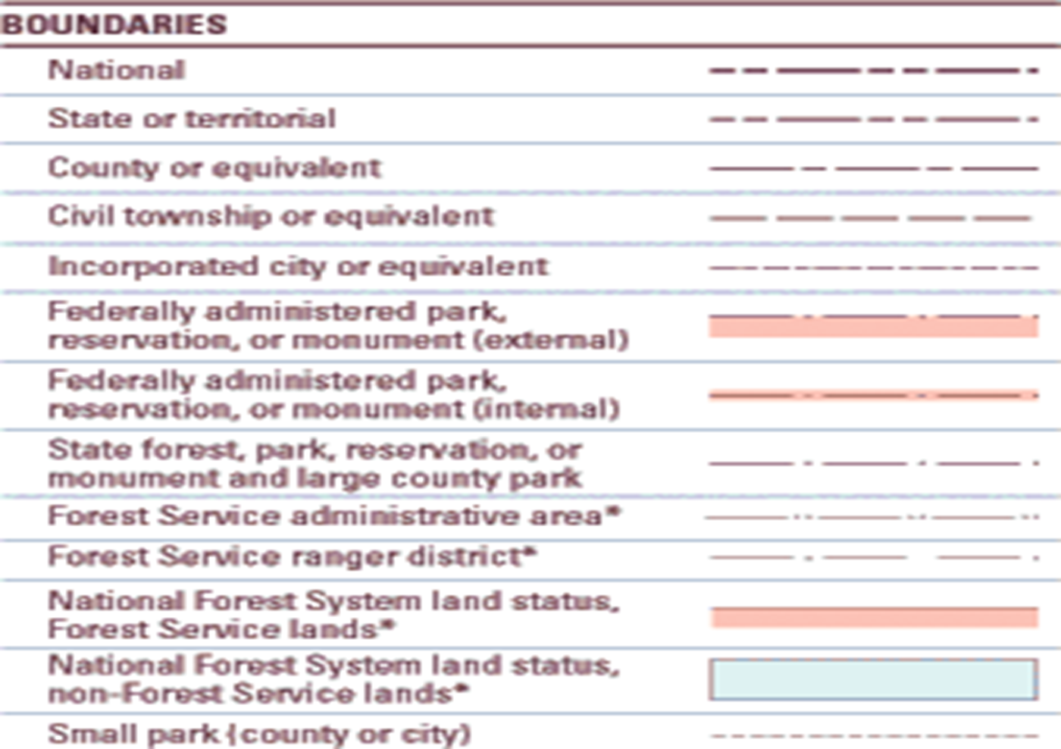
13. Administrative boundaries – It summarizes boundaries which enable the reader to identify the administrative units on the map.

Slide 27
Topographic Map Symbols
Please note a more current and comprehensive Topographic Map Symbols booklet is available in PDF format at http://egsc.usgs.gov/isb/pubs/booklets/symbols/topomapsymbols.pdf.

Slide 28
MAP SCALES

Slide 29
A map is always much smaller than the area it represents!
Maps are made to scale.
The scale represents the ratio of a distance on the map to the actual distance on the ground.

Slide 30
TYPES OF MAP SCALE
1. Written / Verbal/statement Scales: It is the simplest form of map scale e.g. one centimeter on the map represents one hundred kilometers on the earth's surface i.e. 1cm represents 100kms.
2. Linear / Graphic Scale:
It is a line sub-divided into small equal parts.
Each unit marked on the line represents a distance on the actual ground e.g. 1cm on the line represents 1km on the ground.
The zero(0) is placed one unit away from the left end of the linear scale which is again sub-divided to measure a distance less than 1km.

Slide 31
3. Representative Fraction (RF) scale or Ratio scale:
It uses a fraction (or a ratio) to show the relationship between units on a map and units on the earth's surface e.g. 1:50000 or 1/50000.
Convert 50,000cm into meters by dividing 100 and then into km by 1,000.
Therefore a map using the scale of 1:50,000 has a scale of 1cm represents 0.5 km or 500m.

Slide 32
Conversion of scales
Converting RF to statement scale i.e. 1/50,000
Convert the denominator of the RF km e.g. 0.5km
The scale will be read as 1cm represents 0.5km
B. Converting statement scale to RF i.e. 1cm represents 1km.
Express the ground distance in the same units as the map distance e.g. 1km is 100,000cm.
Express the map distance as the numerator and the ground distance as the denominator i.e. 1/ 100,000

Slide 33
C. Converting linear scale into representative fraction(RF):
Convert the linear scale into a statement scale by measuring the distance represented by 1cm.
Convert the statement scale into RF.
D. Converting RF into linear scale:
Convert the RF into statement scale.
Convert the statement scale into linear scale by drawing the line and its sub-division.

Slide 34
E. Converting linear scale into statement scale:
Measure the unit distance off a linear scale.
Convert it into statement scale.

Slide 35
Sizes of scales
Large scale maps e.g. 1:10,000 or 1:25,000, cover relatively small regions in great detail e.g. a town.
Small scale maps e.g. 1:10,000,000, cover large regions such as nations, continents and the whole globe. They show very few details.
Medium scale maps e.g. 1:50,000 or 1:100,000 represent a relatively smaller area. They show more details than small scale.
N/B:- The larger the denominator of RF the smaller the scale.

Slide 36
Uses of scales
Measuring distance on maps
Calculating areas on maps

Slide 37
1. Measuring distances on maps.
Methods used to measure distance accurately on a map include:
Using a piece of string or flexible wire.
Using the edge of a paper.
Using a pair of dividers
N/B: Transfer your measurements to the linear scale provided on the map.

Slide 38
2. Determining areas on a maps
They may include lakes; administrative areas like sub-locations, districts; farms; forests etc.
How to determine areas on maps
N/B:
One grid square represents 1km² on the ground.
Count the number of all full/complete squares and number them.
Count the number of all incomplete squares. All incomplete squares are considered as half squares. So divide these squares by 2 to get full squares

Slide 39
4. Add the full squares in(2) and (3) to get the area in km².
Worked example
With reference to the map of Silaloni 1:50,000 sheet 197/2, answer the questions that follow:
Find the length of all weather road(loose surface) from Silaloni trading centre up to where it crosses the power line in kilometres.
Answer: 7 kms

Slide 40
b) Find the area in km² of Vinagoni/Mizaheni sub-location.
Answer:
No. of full squares = 16
No. of half squares = 27/2 → 13.5
Total full squares = 16 + 13.5
= 29.5 km²

Slide 41
Assignment
With reference to the map extract of Kericho 1:50,000 provided answer the following questions:
Determine the area in km² of Kericho Municipality.
Find the length in kms of the bound surface road of Ainabkoi – Muhoroni and Kisumu road.

Slide 42
THE END

